Slide 1
Field Evaluation of New “Interference-Free” O3 and NOx Monitors
OTC/MANE-VU Committee Meeting
Stationary & Area/Mobile/Modeling/Technical Support
April 12, 2016 – Washington, DC
Will Ollison (American Petroleum Institute)

Slide 2
O3 Inlet Height Effects & Near-Road NO2 Bias
Conventional & “Scrubberless” O3 TAPI T400 Photometer at 2m & 6.2m Inlet Heights
Conventional CL TAPI T200U FRM & New 2B 405nm Photometer NO2 Differences at a Near-Road Site

Slide 3
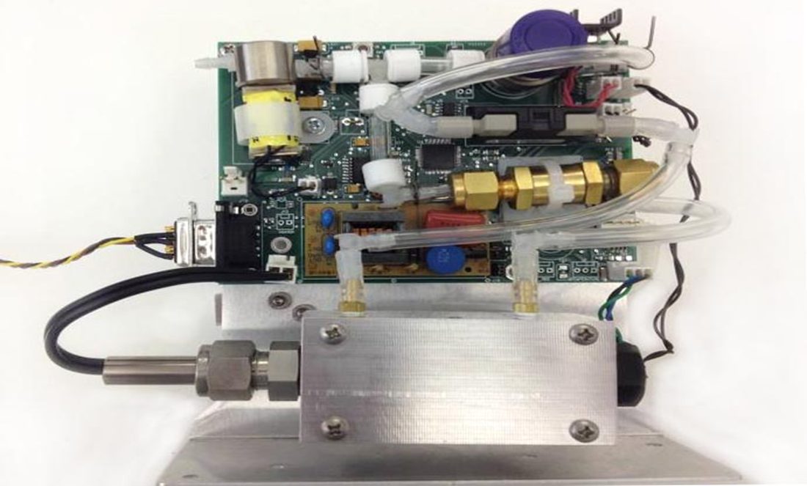
GPT Scrubberless Module™
http://www.twobtech.com/model_GPT.htm

Slide 4
Rolling Hourly Daily 8h O3 (ppb) & 6.2-2m Differences

Slide 5
4th High MD8h O3 Values
Conventional T400 at 6.2 meters = 85.6 ppb (12 days > 70 ppb O3)
Upgraded T400 at 6.2 meters = 84.8 ppb (15 days > 70 ppb O3)
Upgraded T400 at 2 meters = 81.9 ppb (10 days > 70 ppb O3)

Slide 6
Hourly NO2 (ppb) & FRM-2B 405nm NO2 Differences

Slide 7
Hourly Daily Max NO2 FRM-2B 405 Differences
FRM > 2B 405 on 2/3 days by 1-9.5 ppb, averaging 2.6 ppb.
2B 405 > FRM on 1/3 days by 1-4 ppb, averaging 1.8 ppb.
FRM 98th Centile = 47.7 ppb est.
2B 405 98th Centile = 42.9 ppb est.

Slide 8
Recommendations
NAAQS Compliance would benefit from upgrading current O3 network photometer scrubbers or deploying new “interference-free” FEM monitors (TAPI 265 NO-CL or 2B NO-GPT 211).
Lowering network inlets or adjusting Design Values to 2 meters would further improve O3 NAAQS compliance and better represent actual outdoor nose exposures.
Mandated 2016 deployments of improved NO2 monitors [e.g., photolytic converter FRMs or cavity attenuated phase shift (CAPS) FEM 450nm photometers] should also consider 2B 405nm photometers, once FEM certified.

Slide 9
Future 2016 2B Tech O3 and NO2 Photometer Upgrades
A planned 2B heated graphite scrubber kit improves accuracy (e.g., 90-99% less Hg & 80% less p-xylene bias) of conventional O3 254nm photometers - http://twobtech.com/docs/tech_notes/TN040.pdf ; http://twobtech.com/linked_files/Birks_Model_211_Scrubberless_Ozone_Monitor.pdf
A 2B 405 NOx folded cell upgrade improves precision by 30% to ± 2 ppb (±1 ppb with adaptive filter) & response time by 50% to 10 sec - http://twobtech.com/model-405-nm-nox-monitor.html

